Slide 1

BITCOIN PRICE PREDICTION USING SENTIMENT ANALYSIS (ID - 201712-5)
Ketan M. Mehta – kmm2304 | Chandra S Narain Kappera – ck2840 | Venkata Sai Sriharsha Sammeta – vs2626

Slide 2

Outline:
What is BitCoin?
Motivation
System Overview
Data Exploration
Models
Results/Demo
Business model
Future Work

Slide 3

What is Bitcoin ?
Decentralized digital Crypto-Currency
Peer-to-Peer
1BTC = 16, 426 USD (today)!
Enabled by :
Blockchain - distributed immutable ledger
Mining - record-keeping service
Wallets - stores information to transact bitcoins

Slide 4

Why this sudden importance ?
Decentralization - no central authority
Privacy - funds are tied to bitcoin addresses not real-world entities
Scalability - due to Segregated Witness
Reliability - distributed immutable ledger
Result : 1BTC = 1030 USD (Jan 2017) → 16, 426 USD (today)

Slide 5

Why bitcoin price prediction?
1st time Bitcoin users > 10x times this year.
Highly volatile in nature → difficult to predict.
Very high returns than conventional financial trading.
Many newbies want to join everyday
Enter AI !!

Slide 6

Business Proposal:
Capitalize on the idea of increasing interest in Bitcoins
Leverage AI - Predict future price
Automatic alerts system to trade bitcoin
Bank on Big Data Technologies to build scalable model
Minimal investment and maximum returns !!

Slide 7












Technologies Used:

Slide 8

Data Collection:
Collected 3 types of data:
Reddit reviews - from Reddit Archives.
Tweets - using Tweepy API.
Bitcoin Price data - using Coindesk API
Google Cloud Platform + Mysql : To store the continuously fetched data.

Slide 9
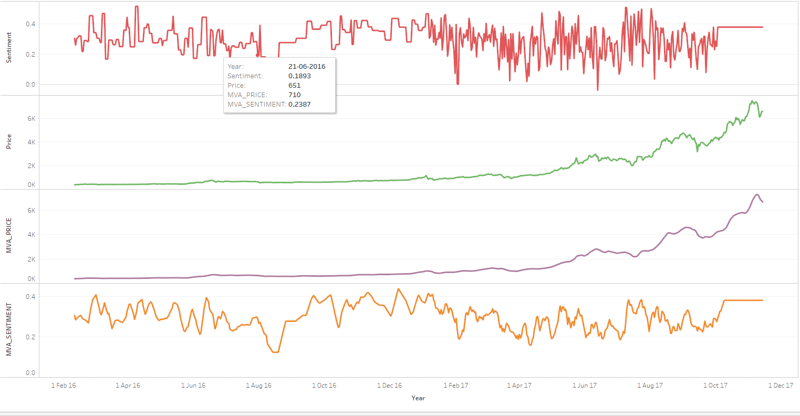
Data Exploration:

Slide 10
Data Preprocessing:
Reddit /Tweets
Stemming,
Tokenization,
Embedding
Sentiment Extraction
Coindesk API
Bitcoin Price
Merge
Feature Vector

Slide 11

Predictive Models:
Two types of Models:
Traditional time-series ARIMA model
Deep Learning Models

Slide 12
ARIMA MODEL
Autoregressive Integrated Moving Average - Time Series model
with lag = 10
with Difference order = 1 to make the time series stationary
with moving average = 2
Train / Test : 70/30 ratio
Total MSE: 104.41

Slide 13
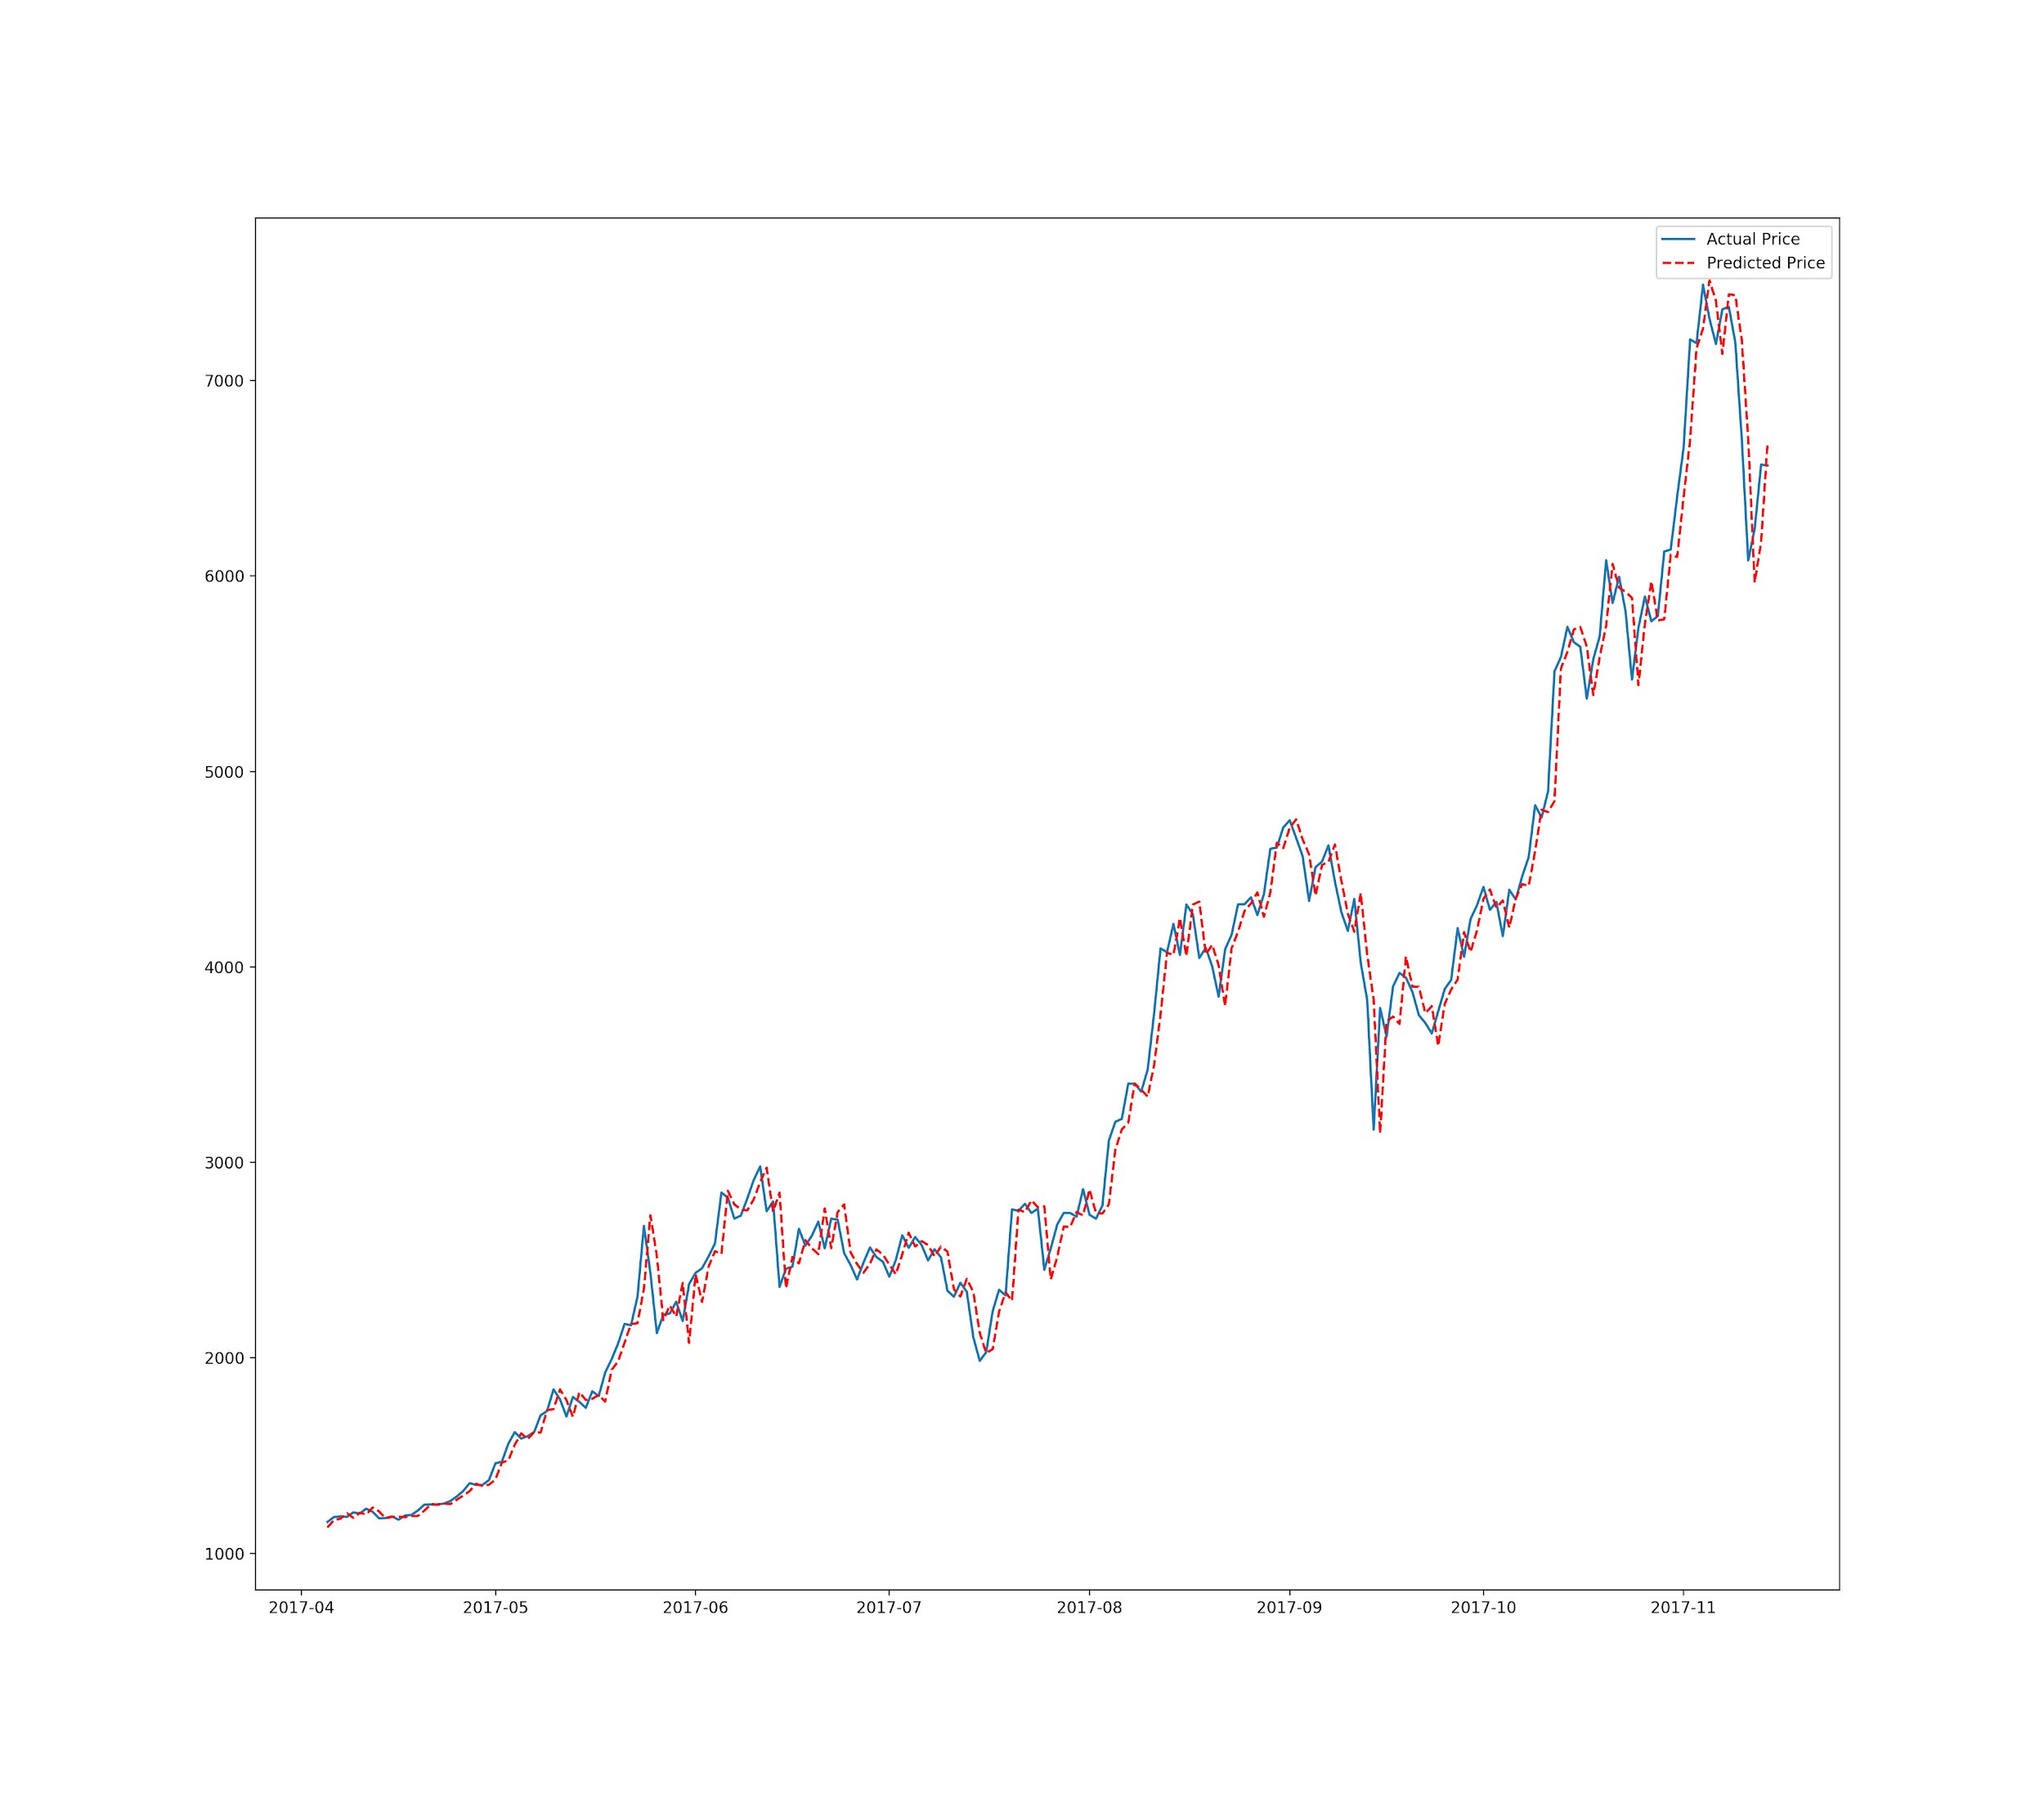
ARIMA plots and performance:
Mean Squared Error:
104.41

Slide 14
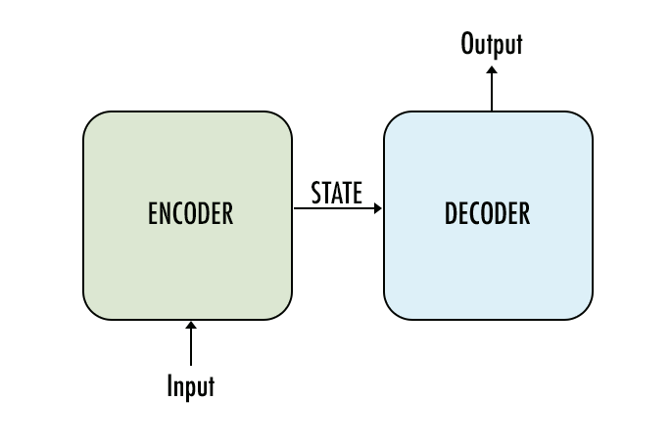
Deep Learning Model:
Simple Sequence to Sequence to model
1000 Hidden Dimension for Encoder and Decoder LSTMS
KERAS and Tensor Flow
Adam Optimizer | 100 Batchsize | 300 epochs
Loss function: Minimize Mean Squared Loss

Slide 15
Deep Learning Model - Performance:
Input Sequence Length | RMSE
Lookback = 1 | 85
Lookback = 2 | 42
Lookback = 3 | 62
Lookback = 2 + Sentiment | 32 ✅

Slide 16
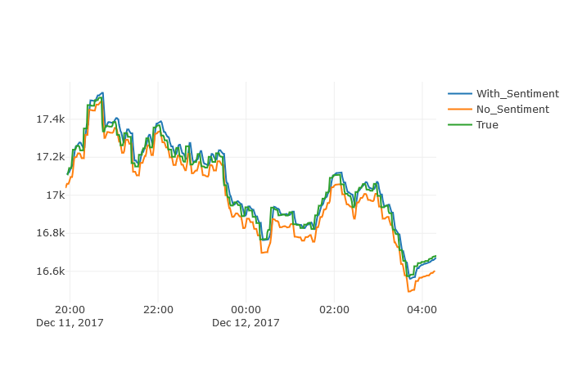
Deep Learning Model - Prediction Plots:

Slide 17

Notification System:
if (future bitcoin price > ‘+’ threshold of diff) → SMS ‘Buy’
if (future bitcoin price < ‘-’ threshold of diff) → SMS ‘Sell’
Twilio: Event triggered programmable alerts sent via sms/pictures.
used Twilio API to send SMS to registered users

Slide 18






Automated Pipeline:
Posts / Reddits on ‘Bitcoin’ or ‘BTC’
Model:
LSTM Sequence-to-Sequence
Bitcoin Price
(CoinDesk API)
Data Collection &
Data Preprocessing
Presentation:
Bitcoin Price Chart
Notifications:
SMS Alerts (Buy / Sell)
Tweets about ‘Bitcoin’ or ‘BTC’
Data Storage
Google Cloud - Compute & SQL Instance

Slide 19
Demo

Slide 20
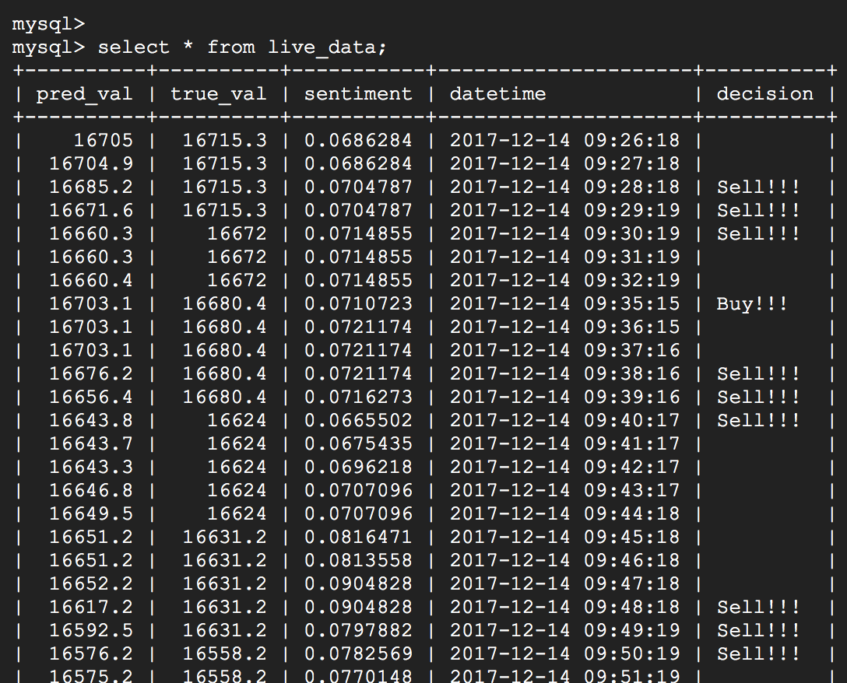
Demo - Real-Time predictions database in mysql

Slide 21
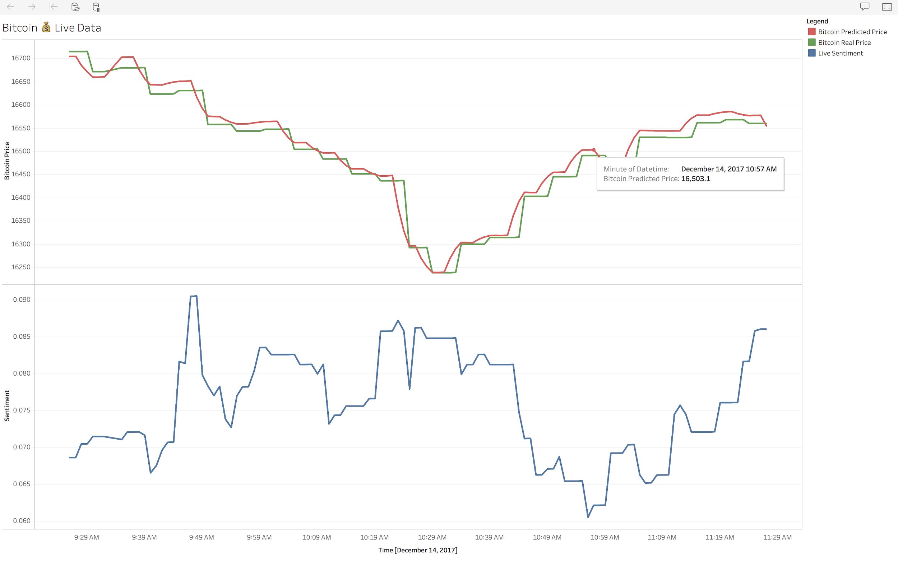
Demo - Tableau plots

Slide 22
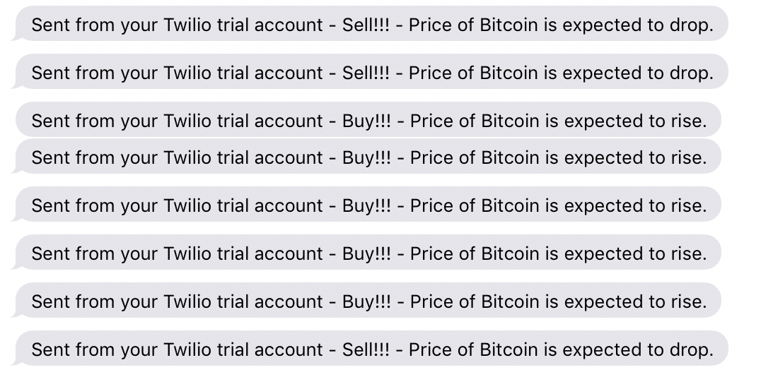
Demo - Real-Time SMS Notifications using Twilio

Slide 23

Future:
Add more sources → improve predictive power
Automated Bitcoin trading
Extend it to other crypto-currencies such as Etherium
Incorporate more robust models
Venture Capital and Startup !!

Slide 24

Questions:

Slide 25
Thank you

